Slide 1
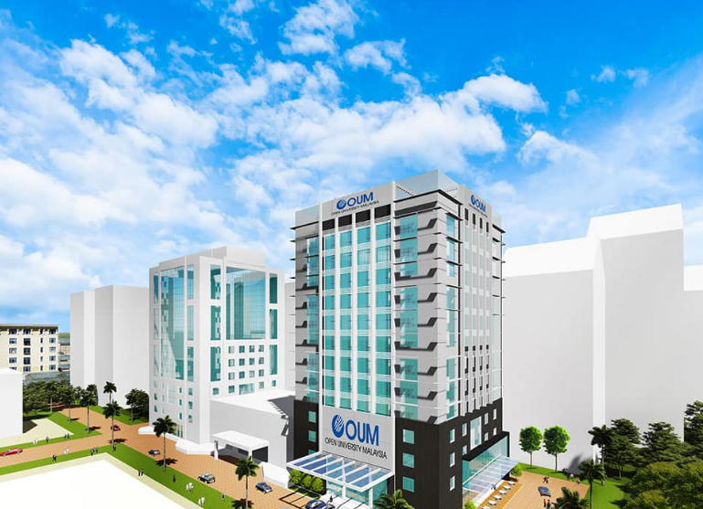
TAKE THE LEAD with
MOSHRM

Slide 3
WHY MOSHRM?
MOSHRM
Stay competitive in job market
Be the Specialist in OSH Risk Management
Act as OSH Advisor and Consultant
Take the lead in OSH risk management

Slide 4
PROGRAMME RECOGNITION
MQA/FA 0538
JPA APPROVED
DOSH (JKKP IS 127/438/3/75)

Slide 5
PROGRAMME EDUCATIONAL OBJECTIVES (PEOs)
PEOs | Description
PEO1 | Knowledgeable and competent in occupational safety and health discipline in-line with the industry requirement.
PEO2 | Effective in communication and social skills for good teamwork and demonstrate skillful leadership quality in managing occupational safety and health matters in an organisation.
PEO3 | Capable to solve occupational safety and health problems innovatively, statistically and ethically through sustainable risk management approach.
PEO4 | Able to demonstrate entrepreneurship skills and incorporate information management and life long learning for successful career development in occupational safety and health.

Slide 6
PROGRAMME LEARNING OUTCOMES (PLOs)
PLOs | Description
PLO1 | Apply the relevant occupational safety and health body of knowledge in professional practice to solve real-world projects.
PLO2 | Apply critical thinking skills for decision making logically, analytically and creatively based on sound facts and ideas.
PLO3 | Demonstrate the skills and principles of lifelong learning in their academic and career development in occupational safety and health.
PLO4 | Demonstrate an appropriate social skills in occupational safety and health.
PLO5 | Communicate creative and innovative ideas effectively with team members and stakeholders for continually improve occupational safety and health performance.

Slide 7
PROGRAMME LEARNING OUTCOMES (PLOs)
PLOs | Description
PLO6 | Appreciate digital technology to support and enhance occupational safety and health management.
PLO7 | Appreciate data relating to statistical technique and organisation activities.
PLO8 | Perform leadership in managing risk and taking full responsibilty for the success of the preventive culture.
PLO9 | Develop sustainable occupational safety and health risk management skills.
PLO10 | Develop innovative entrepreneurial skills that benefits both organisation and industry.
PLO11 | Manage safety and health risks in accordance to ethical and legal practices.

Slide 8
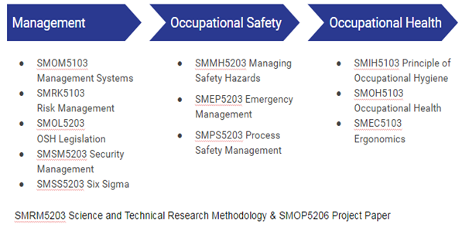
WHAT IS IN MOSHRM?

Slide 9
MOSHRM ASSESSMENT
Course Code | Course Title | Assignment (%) | Final Exam (%)
SMRK5103 | Risk Management | 100 | NA
SMOL5203 | OSH Legislation | 100 | NA
SMOM5103 | Management Systems | 100 | NA
SMSS5203 | Six Sigma | 60 | 40
SMOH5103 | Occupational Health | 60 | 40
SMEC5103 | Ergonomics | 60 | 40
SMPS5103 | Process Safety Management | 60 | 40
SMMH5203 | Managing Safety Hazards | 60 | 40
SMRM5203 | Science and Technical Research Methodology | 100 | NA
SMIH5103 | Occupational Hygiene | 60 | 40
SMEP5203 | Emergency Management | 60 | 40
SMSM5203 | Security Management | 60 | 40
SMOP5206 | Master Project | Master Project + Presentation | NA

Slide 10
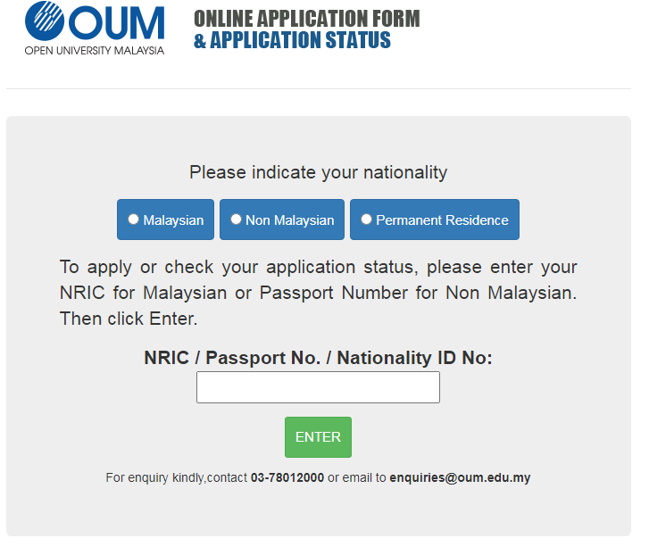
THANK YOU

